Slide 1

Pure CSS/HTML GAME
Group 7
Zahra ARABLOU, Chunmei LIU, Ying LUO

Slide 2
Game Introduction
Front page
Game page
Introduce to game page
15 second counter down shooting game
Automatically calculator the shooting result
Time's up and replay
Welcome

Slide 3
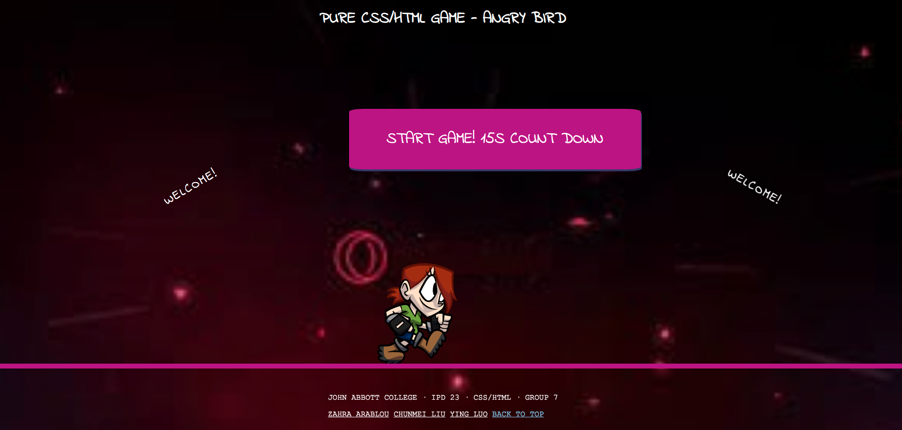

Slide 4
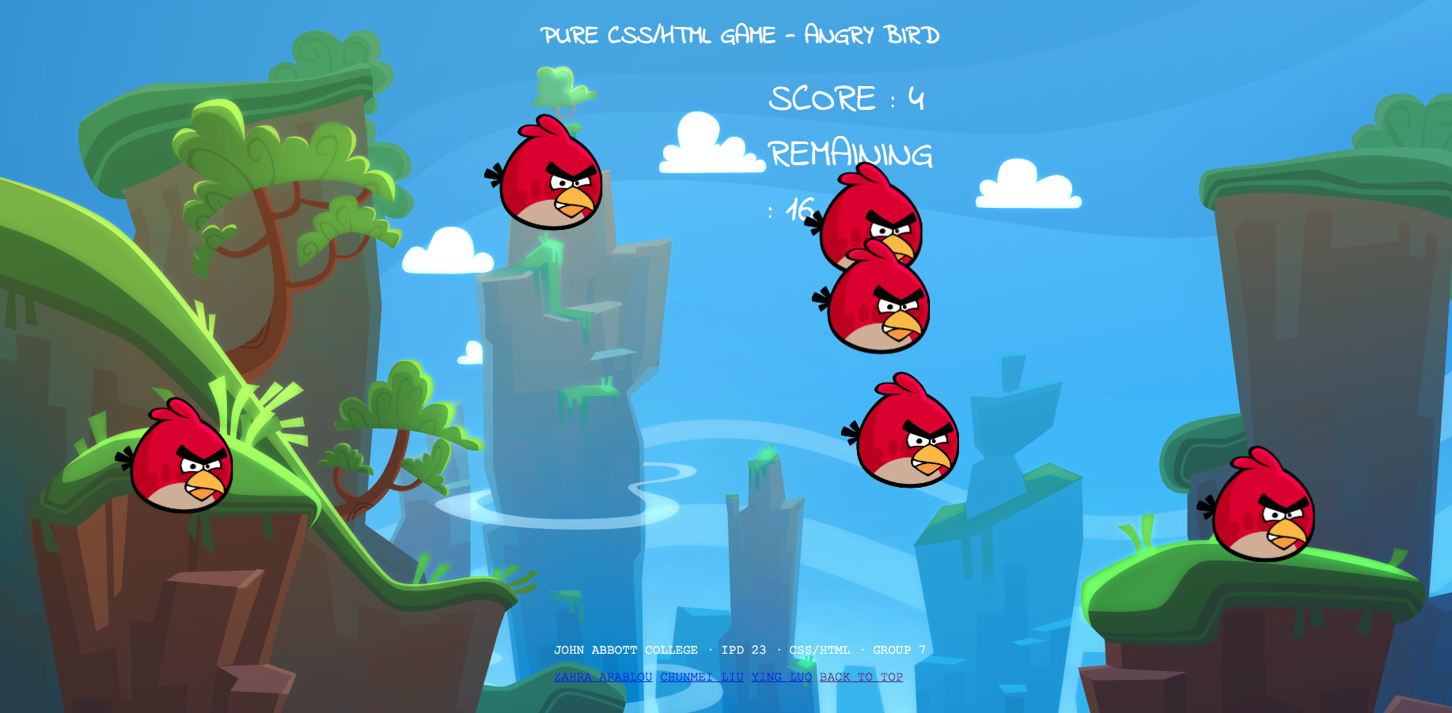

Slide 5
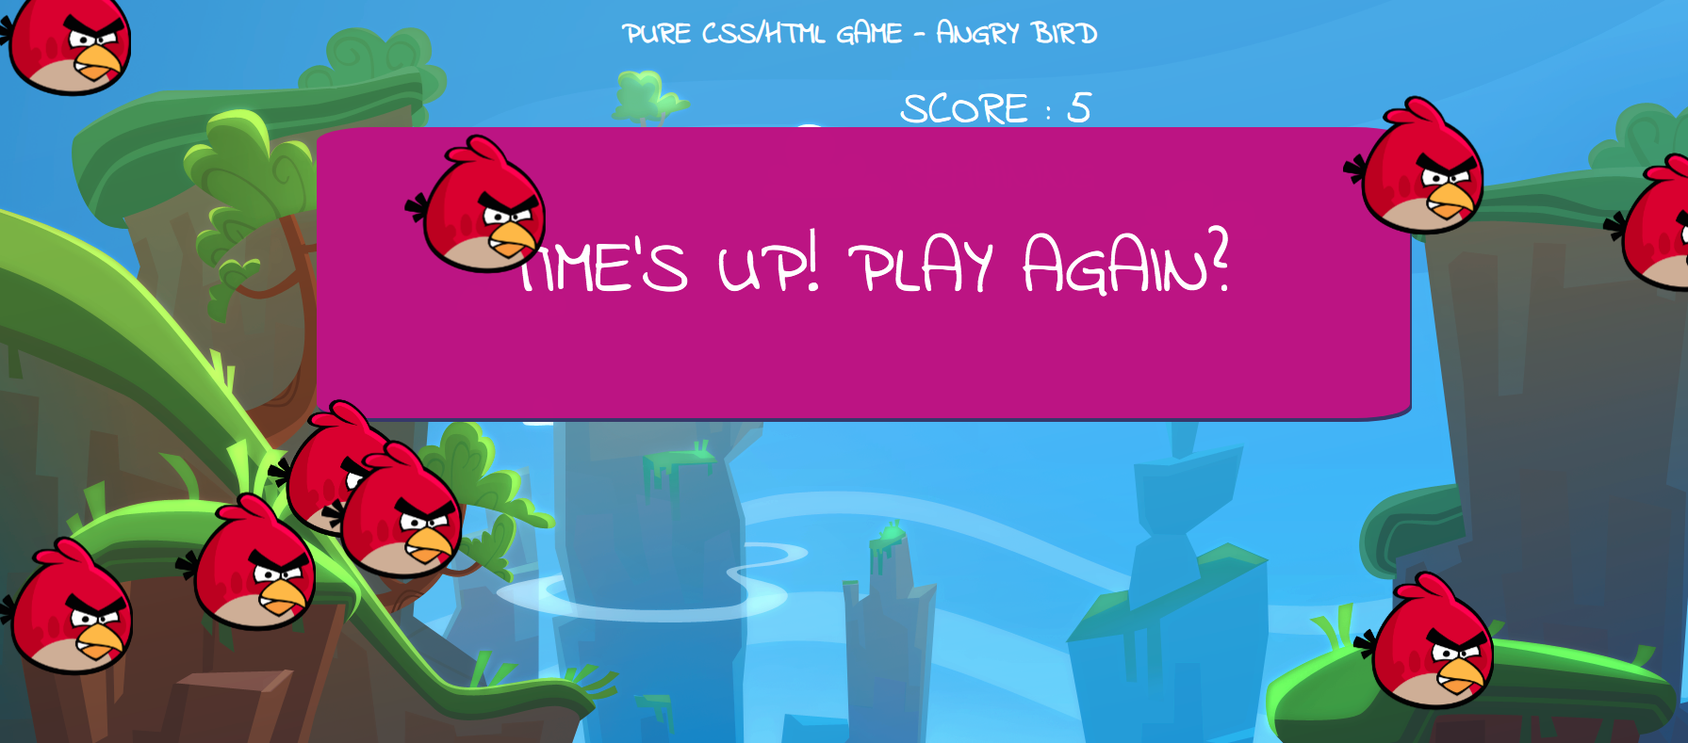

Slide 6
Code Management
https://github.com/Ying-LUO/Pure-CSS-Project-Group7
HTML Structure
CSS Effect
GitHub
Index.html -- Main page
Game.html-- Game page
Transition: delay
Transform: rotate
Sprite sheet background-position animation
Button rotate animation
Button delay animation
Game bird translate verital and horizonal animation
Font-size animation
Pseudo Element/Class:
Automatic Number countering by Counter-increment
Before/after
Anchor link: LoVe HAte
Nth-of-type(nth+startNumber)

Slide 7
Technique used
Transition
Transform
Animation
--"animation: fly 12s 12.5s linear infinite;"
Used to control the start entrance of all the birds in the game
--"transition: all 0.6s;"
Used to control the welcome letter effect in the front page
--"transform: rotate(-30deg);"
--"animation: walk 1s steps(6) infinite, forward 10s linear infinite;"
Used to control the bird fly forward and float virtically
--"animation: float 2s infinite cubic-bezier(0.58, 0.14, 0.46, 0.92);"
Used to control the sprite sheet to walk and go forward

Slide 8
Reference Game
https://medium.com/cssclass-com/how-to-create-pure-css-games-2a29c777bf4
How to Create Pure CSS Games
Shoot to kill CSS Game
https://codepen.io/taneleero/pen/ZOvAxN
CSS Sprite Sheet Animation
https://www.youtube.com/watch?v=nQXGFit9ICI
GameMaking – Game03 from LEA

Slide 9
Blocked Issue
Structure of bird object, learn from the "How to Create Pure CSS Games" in reference but failed on html validation
Reason: Div is a block element, so cannot go inside a label which will only accept Phrasing content.
Solution: change div into span
Problem: Label with block tyep div nested
Issue: cannot set the event after object been checked

Slide 10
Q&A
Thank you!

